Slide 1
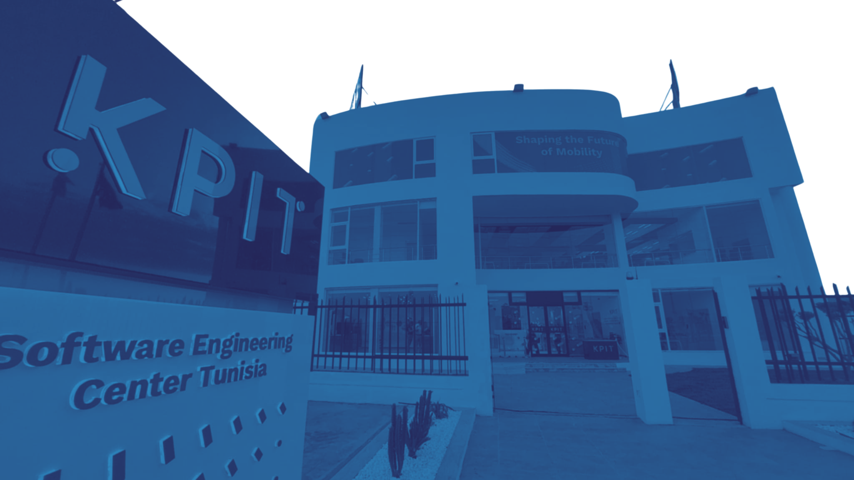

Configuration Management System
for Hardware & Logical Channels
A VS Code Extension for the MTF (Modular Test Framework)
Presented by:
Supervised by:
Rahma BRADAI
Yosra HADJ TAIEB
Hamza RGAIEG
1
Notes:
Good afternoon, my name is Rahma Bradai, and today I will present the solution which is supervised by yosra hadj taieb and hamza rgaieg , this project is designed to simplify configuration management in automotive testing environments.

Slide 2














AGENDA
Business Context
Target
Users
01
Problematic
02
03
Status
&
Next Steps
Proposed Solution
04
Live Demo
05
06
2
Notes:
Here is the plan for today's presentation.
I'Il start with the business context
- what is a test bench,
and MTF FRAMEWORK,
Then I'll go deep into the problematic:
why manual configuration was a problem.
After that, I'll present the defined solution,
the key features,
and wrap up with a live demo
and the next steps planned before the end of the
internship.

Slide 3
01
BUSINESS CONTEXT:
AUTOMOTIVE ECU TESTING
3
Notes:
Starting with Business Context, this project is part of the automotive domain, specifically ECU testing.
Before deploying ECUs into real vehicles, they must be tested to ensure safety.

Slide 4






COMPANY AND DOMAIN CONTEXT
DOMAIN
MTF
Automative embedded systems testing and validation environment
A framework that routes signals between software and physical test hardware
DAILY TOOLS
NEED
  VS Code
  MTF Framework
  YAML configuration files
Faster and more reliable setup
4
Notes:
To better understand the context:
Here are some definitions.
A test bench is a physical setup that simulates a vehicle’s electronic system.
And the MTF framework is a platform that manages communication between test software and hardware devices.
To run correctly, it requires a configuration file called config.yaml.

Slide 5
02
PROBLEMATIC:
UNDERSTANDING EXISTENCE
5
Notes:
The main issue is that configuration is currently done manually.

Slide 6







BUSINESS PROBLEM
YAML files are complex and require strict syntax and domain knowledge
Mistakes cause delays in test bench setup and Rework
Reduce team productivity
MTF configuration is currently time-consuming and error-prone when done manually
Engineers need faster onboarding and more reliable configuration workflows
6
Notes:
This leads to multiple problems:
Errors like:
- invalid field names are only detected at runtime
- Incorrect mappings cause test failures
- Duplicate IDs can corrupt configurations
- There is no tool support, only text editing
- And onboarding new engineers becomes slow”

Slide 7

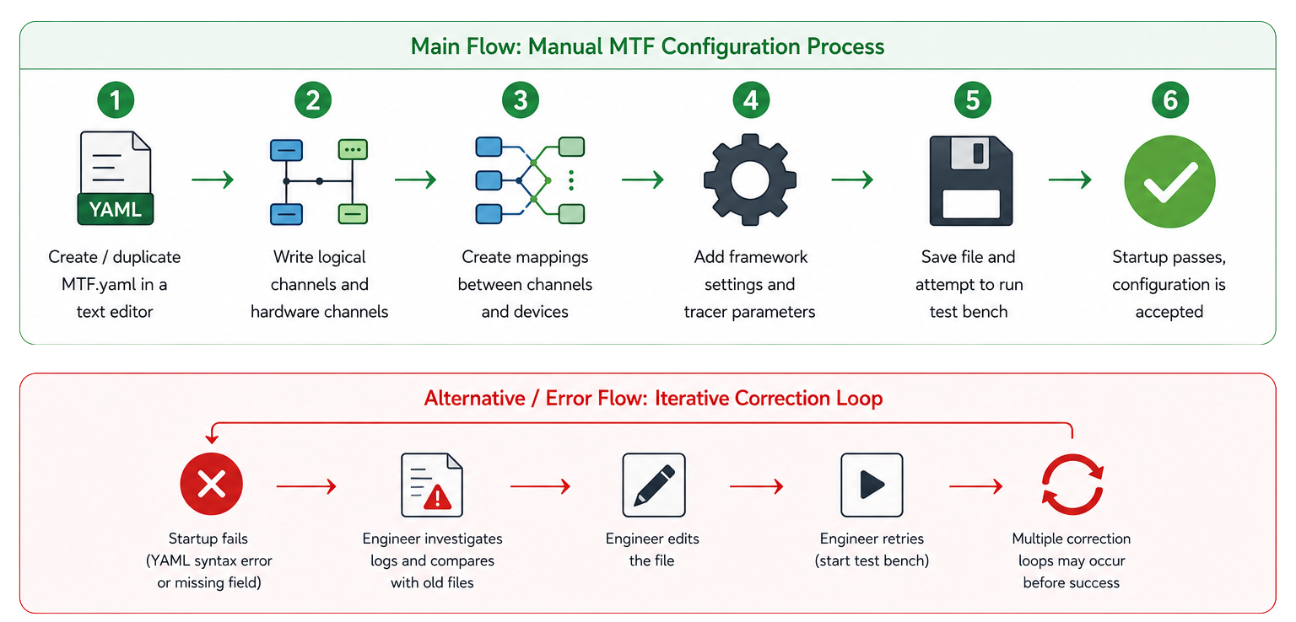
USE CASE EXAMPLE
7
Notes:
For example, a simple typo in the YAML file can cause the entire test session to fail.
This shows how error-prone the current approach is.

Slide 8




WHY THIS MATTERS OPERATIONALLY
01
02
03
04
Configuration errors =>
Delayed test execution
Rework Loops =>
Lost engineering hours
Tribal knowledge dependency =>
Team fragility
Lack of standardization =>
Inconsistent outputs across projects
8
Notes:
This leads to multiple problems:
Errors like:
- invalid field names are only detected at runtime
- Incorrect mappings cause test failures
- Duplicate IDs can corrupt configurations
- There is no tool support, only text editing
- And onboarding new engineers becomes slow”

Slide 9
03
TARGET USERS:
SKATEHOLDERS AND STRATEGIC VISION
9
Notes:
To solve this, we developed a Channel Configuration Manager System.
It's designed to automate, validate, and simplify the configuration process.

Slide 10







TARGET USERS
01
Automative test engineer/ Developer
QA leads, project managers
02
  Configures test benches daily
  Needs speed, correctness, and continuity
  Need consistency and traceability
Primary User
Secondary User
Indirect beneficiaries
Tertiary User
04
03
Delivery Team
Validation Team Lead
  Benefit from fewer delays and rework loops
  Plans campaign readiness and resource allocation
10
Notes:
The system automatically builds the config.yaml file by
- serializing all components including logical, hardware channels , mappings framework configuration
and
- validating them before execution.

Slide 11

PROJECT VISION
Turn MTF configuration from a fragile manual task into guided, reliable, and reusable workflow
Business Objectives
Reduce configuration preparation time
Reduce avoidable configuration errors
Improve consistency across projects
Improve onboarding speed
Support operational continuity
11
Notes:
The system automatically builds the config.yaml file by
- serializing all components including logical, hardware channels , mappings framework configuration
and
- validating them before execution.

Slide 12
04
DEFINED SOLUTION:
SCOPE
12
Notes:
To solve this, we developed a Channel Configuration Manager System.
It's designed to automate, validate, and simplify the configuration process.

Slide 13






HIGH LEVEL
Guided configuration through UI
Automatic YAML genration
Live preview and import /edit
Mapping and framework setup
Embedded documentation assistant
13
Notes:
The system automatically builds the config.yaml file by
- serializing all components including logical, hardware channels , mappings framework configuration
and
- validating them before execution.

Slide 14



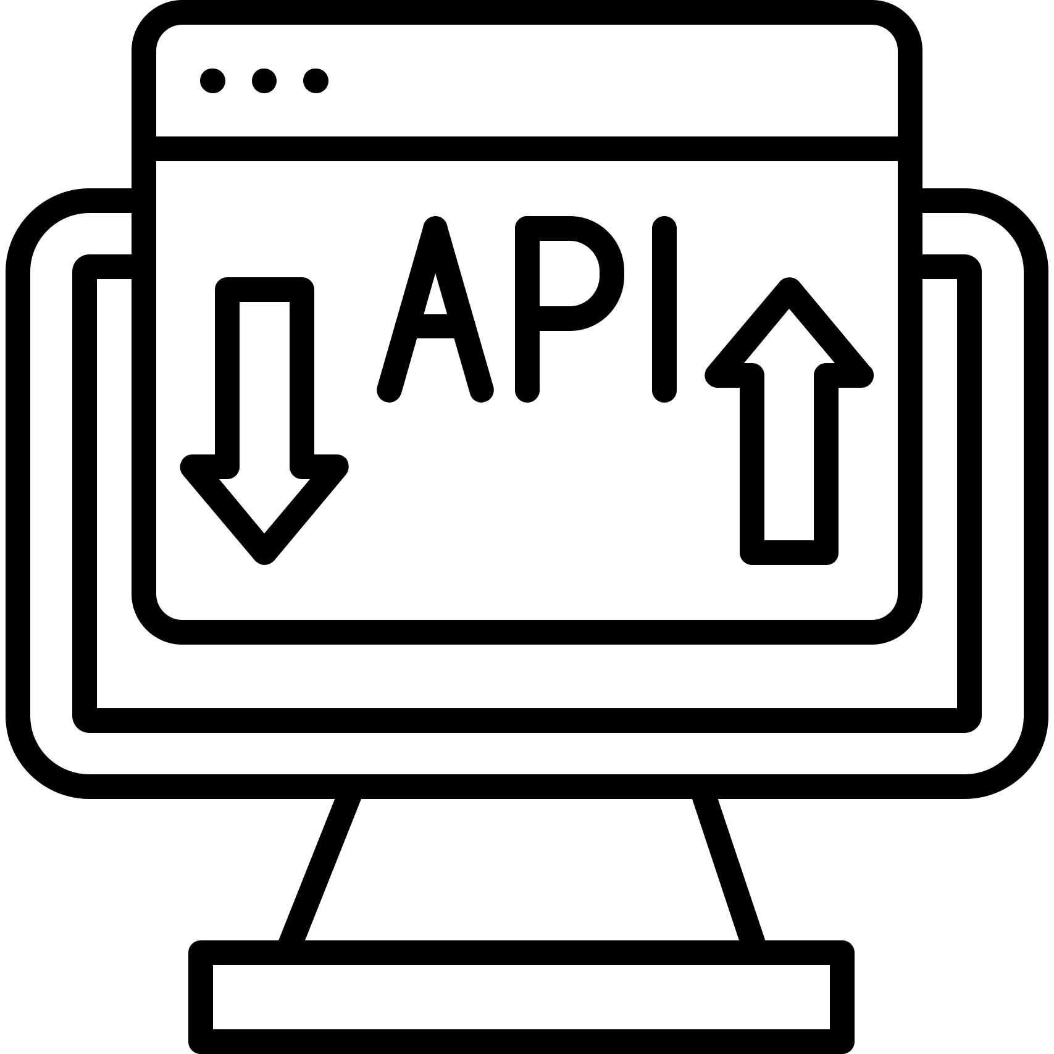


TECHNOLOGY STACK
Used Technologies
Extension
Frontend UI
VS Code API
React (Webview)
Backend API
Database
Node Js
PostegreSQL via TypeORM
Auth
JWT
14
Notes:
The system is built using modern technologies:
Node.js for the backend
React for the frontend
PostgreSQL for the database
JWT for authentication
And the VS Code API for integration.

Slide 15

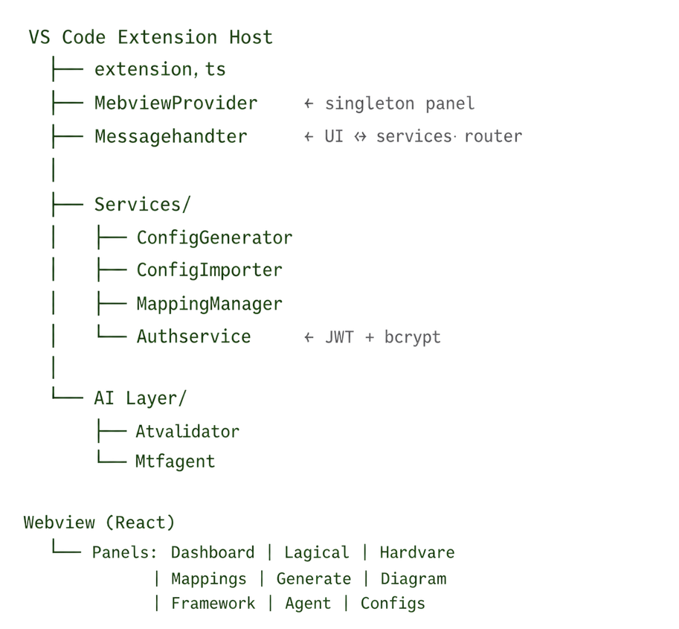





ARCHITECTURE
01
02
03
Singleton Webview Panel
SOLID Principles
Two-bundle Webpack
Singleton Webview Panel
One persistent React app injected into VS Code
One persistent React app injected into VS Code
Extension and Webview are built separately
15
Notes:
The architecture follows SOLID principles.
We use a singleton webview panel inside VS Code, and separate builds for the extension and the UI.

Slide 16
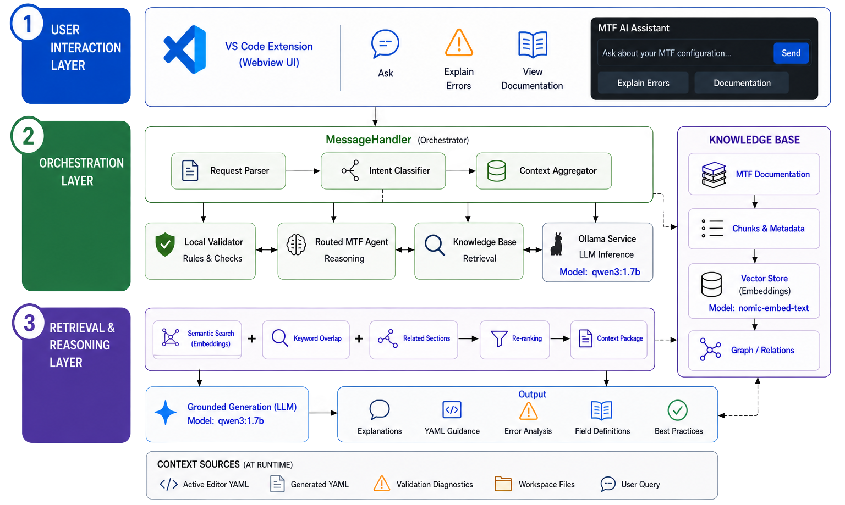

MTF AGENT SUPPORT
16
Notes:
This diagram presents the architecture of our AI assistant for MTF configuration.
We start with the user interaction layer, where the user can ask questions, understand errors, and explore documentation.
Then comes the orchestration layer, which manages the system: it receives the request, identifies the intent, gathers context like YAML and diagnostics, and routes it to the right components.
At this level, we have three key parts:
a local validator for rule-based checks,
an agent for reasoning,
and a knowledge base for documentation retrieval.
We also use a local model, Qwen 3 (1.7B parameters), for response generation.
Next is the retrieval and reasoning layer, where information is retrieved using semantic search and keyword matching, supported by nomic-embed-text embeddings, and used to generate grounded responses.
Finally, the system outputs explanations, error analysis, and YAML guidance, all based on real data

Slide 17
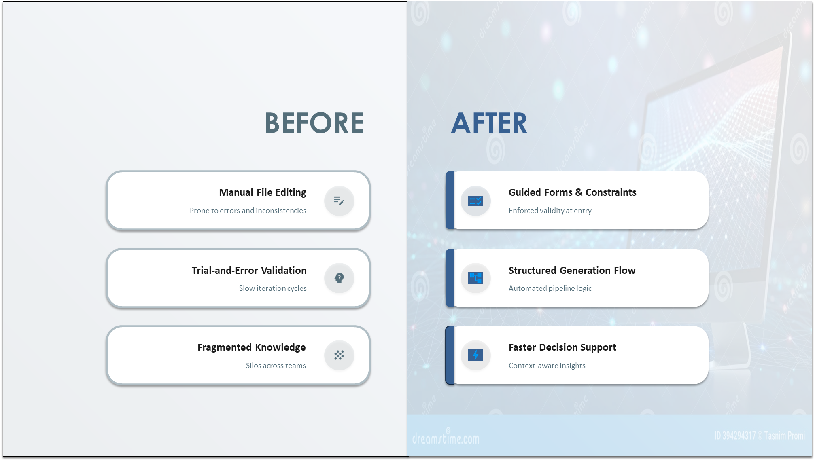
PROCESS
Notes:
These slides detail the structure of logical and hardware channels.
Logical channels define parameters like name and ID, and support multiple types such as CAN, LIN, and Ethernet.

Slide 18



FUNCTIONAL COVERAGE DELIVERED
Mapping Logic
+
Framework Config
YAML Generation
2
3
1
4
MTF Agent Support
Channel Management
Config Pipeline
18
Notes:
The system automatically builds the config.yaml file by
- serializing all components including logical, hardware channels , mappings framework configuration
and
- validating them before execution.

Slide 19
05
LIVE DEMONSTRATION
19
Notes:
In the demo, I will show the full workflow:

Slide 20

DEMONSTRATION WORKFLOW
Framework Configuration Flow
Hardware Channels Flow
Mapping Validation Flow
05
04
Logical Channels Flow
MTF Agent Support
03
02
20
01
Notes:
Creating hardware channels
Defining logical channels
Mapping them with validation
Configuring the framework
And using the MTF agent for support

Slide 21
06
STATUS & NEXT STEPS
21
Notes:
Moving on to the last part
which outlines our current progress and next steps of the project

Slide 22
CURRENT STATUS
01
Logical Channels CRUD
+
04
Config.yaml Generation
hardware Channels CRUD
02
05
User Authentication
+
Diagram and Dashboard Visualization
Mapping Engine + Validation rules application
03
06
Framework Configuration CRUD
MTF Agent For User Support
22
Notes:
Currently, most core features are implemented:
CRUD operations for channels
Mapping engine with validation
Configuration generation
Authentication and dashboard visualization

Slide 23


NEXT STEPS
Approaches
01
AI optimization (analyzing errors better)
02
Hardware auto Discovery
03
Interactive Diagram( Drag and Drop)
04
Dockerization and Deployment
23
Notes:
For future improvements, we plan to add:
AI-based validation
Hardware auto-discovery
Drag-and-drop diagrams
And deployment using Docker

Slide 24

THANK YOU
FOR YOUR ATTENTION AND PARTICIPATION!
24
Notes:
Through this project, we were able to simplify the configuration process for ECU testing environments.
By replacing manual editing with a structured tool, we reduced errors and improved efficiency.
Thank you for your attention and participation

